Slide 1
Git – Introduction
Module 7

Slide 3
Git setup

Slide 4
Scenario overview
You are tired of having different versions of the same scripts running in your environment.
You want to be able to leverage version control within your script repository.
Your engineers are confused on updates and which version of a specific script or file they are supposed to be used.
You want control over your scripts used in the production environment.

Slide 5

What is DevOps?
The union of people, process, and products to enable continuous delivery of value to your end users.
The contraction of “Dev” and “Ops” refers to replacing siloed Development and Operations to create multidisciplinary teams that work together with shared and efficient practices and tools.

Slide 6
DevOps – Deliver Faster, Smarter, and Continuously
Plan
Monitor + Learn
REQUIREMENTS
BACKLOG
Development
Production
Collaboration
Develop + Test
Release
Notes:
So what are the solutions to these challenges?
Applying agile practices to develop ‘Modern Apps’ holds great promise when executed properly:
Faster and more frequent delivery
Higher Quality
Increased Stakeholder satisfaction
Higher ROI – continuous delivery of value
Note the roles engaged in each of the phases – and notice that at the heart of all this is ‘Collaboration’. The whole team is aligned and collaborates throughout the lifecycle.

Slide 7
Introduction To Version / Source Control
Version control of scripts, files, applications, etc.
Records changes to a file or set of files over time
Allows file / project versioning
Local or centralized
Distributed version control change repository option
Easily swap versions
Ideal for teams
Undo changes
Stored on each machine
Notes:
Version control is a system that records changes to a file or set of files over time so that you can recall specific versions later.

Slide 8
Types of Version Control
Distributed
Everyone has a copy
Changes made locally
Centralized
Master copy is stored centrally
Requires network connectivity
Merged with an online central copy
Doesn’t generally require connectivity

Slide 9
CI/CD strategy
Continuous Integration (CI)
Team develops from same repository
Limited drift from master branch
Results contain few bugs
Software works properly
Continuous Delivery (CD)
Produce software/updates in short cycles
Allows: building, testing, and releasing code with greater speed and frequency
Reduces: cost, time, and risk of delivering changes by allowing for more incremental updates to applications/scripts
Notes:
CI: “… a software development practice where members of a team integrate their work frequently, usually each person integrates at least daily - leading to multiple integrations per day. Each integration is verified by an automated build (including test) to detect integration errors as quickly as possible. Many teams find that this approach leads to significantly reduced integration problems and allows a team to develop cohesive software more rapidly.”
Source: https://martinfowler.com/articles/continuousIntegration.html
“… a software engineering approach in which teams produce software in short cycles, ensuring that the software can be reliably released at any time. It aims at building, testing, and releasing software faster and more frequently. The approach helps reduce the cost, time, and risk of delivering changes by allowing for more incremental updates to applications in production. A straightforward and repeatable deployment process is important for continuous delivery.”
Source: https://en.wikipedia.org/wiki/Continuous_delivery

Slide 10
Source Control Management
Harness collaboration
Enable parallel development
Minimize integration debt
Act as a quality gate

Slide 11

What is Git?
Distributed version control system
Created in 2005 by Linus Torvalds
Lightweight and fast
Supports parallel development (branching)
Fully distributed
Open Source
Integrated with many Content Index (CI) tools
Notes:
Source: https://git-scm.com/
Git is a free and open source distributed version control system designed to handle everything from small to very large projects with speed and efficiency.
Git is easy to learn and has a tiny footprint with lightning fast performance. It outclasses SCM tools like Subversion, CVS, Perforce, and ClearCase with features like cheap local branching, convenient staging areas, and multiple workflows.

Slide 12
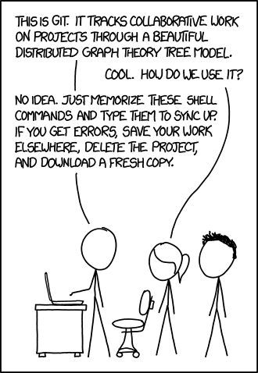
Challenges of Git
New for many operational engineers
Command line based
What’s the point?
Afraid to use Git
New toolset
Very powerful (“Dangerous”)
Not user friendly
I don’t want to become a developer
Notes:
Reference: https://xkcd.com/1597/
Despite the “easy” learning curve, the idea of Git can be a bit much to think about. Once the core concepts are understood, Git becomes an indispensable tool.

Slide 13
Git Commits
Retains each version by tracking ALL changes
Displays exact changes
Undo is holistic and reverts

Slide 14
Git Setup
Clone
Create a new local repository to clone data into
Copy existing repository to clone location
Adds .git folder
Adds remote origin
Run with: git clone ssh_url
Notes:
Presenter note: We talk more about this process in upcoming slides. This is a high level of cloning a project.

Slide 15
Git Structure
A Git repository is created by using git init
Git creates a .git folder
.git folder contains information needed for Git to function
To remove Git, remove the .git folder and retain all project files
Notes:
Reference: https://git-scm.com/docs/gitrepository-layout

Slide 16
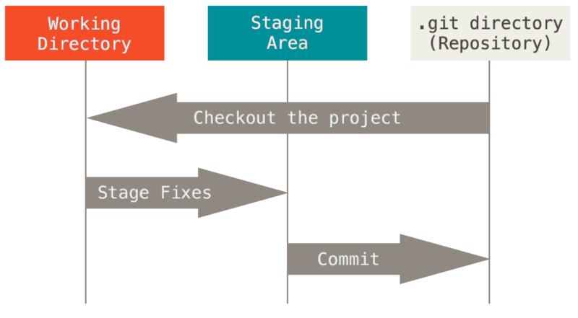
Git Layers
Three stages to track changes:
Working directory
Index/staging
HEAD
Notes:
Reference: https://git-scm.com/book/en/v2/Getting-Started-Git-Basics

Slide 17
Git Process
Working directory
git add
Index/ staging
git commit
HEAD
git push
GitHub
git remote add origin ssh_url

Slide 18
Logging into a Git Repository

Slide 19
Repositories
Can be either hosted online or local (GitHub, GitHub Enterprise)
Represents the main project
Contains: files, commits, branches, and history for the entire project
Best practices:
Maintain a single source repository
Place all needed content for a project in a single repository
Minimize branches
Notes:
GitHub is only one option for hosting

Slide 20
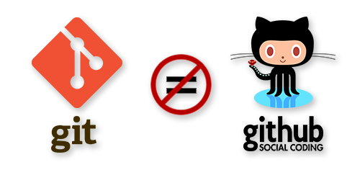
Git vs. GitHub
Git: a revision control system, a tool to manage your source code history
GitHub: a hosting service for Git repositories, only stores code
Notes:
Many other Git repositories exist but GitHub is one of the most popular.

Slide 21
Create Repository
Create New – git init <RepositoryName>
Clone from another location – git clone <location .git>
A local copy of source files is available
PS c:\> git init MyNewRepository
Initialized empty Git repository in C:/MyNewRepository/.git/
PS c:\> git clone https://github.com/anwaterh/MyNewRepository.git
Cloning into 'MyNewRepository'...

Slide 22
Workspace / Staging Area
Files are created / edited in your workspace
To track a file it first must be added to the staging area
Staged files can then be committed (snapshot of the current staging area)
All files / changes can be added – or only individual files
Create New File(s)
Add to Staging Area
Commit File(s)

Slide 23
Adding Content to Staging Area
Add a file to staging area – git add <filename>
Add all files to staging area – git add .
PS c:\MyNewRepository> git add .\script.txt
PS c:\MyNewRepository> git status
On branch master
No commits yet
Changes to be committed:
(use "git rm –cached <file>... " to unstage)
new file: script.txt

Slide 24
Removing Staging Area Content
Remove a file from staging (won’t be part of the commit)
PS c:\MyNewRepository> git rm .\script.txt –cached
Rm 'script.txt'
PS c:\MyNewRepository> git status
On branch master
No commits yet
Untracked files:
(use "git add <file>..." to include in what will be committed)
script.txt
Nothing added to commit but untracked files present (use "git add" to track)

Slide 25
Commit
Snapshots the repository at that point
All staged files become part of the commit
Saves email address and username
Contains a message describing the changes
Commit has a unique hash which is used as a reference
Use a text editor or the –m switch to provide the message

Slide 26
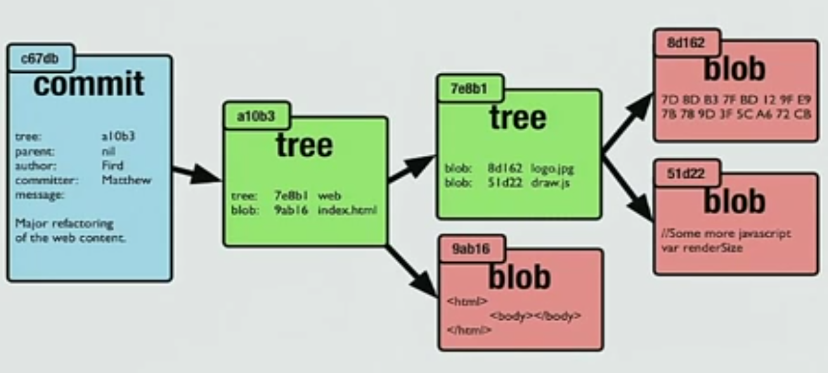
Commit - Under the Hood
Commit stores the entire blob, not just deltas as hashes: 530a6ac7c3682458ec6307a7c2c350ed849bfaf7
Not duplicating content – leverage same blob
Multiple commits can point to the same blob content
Commit points to a tree, then to a blob
Object DB used
Start with root tree
Updates parent
.git folder to start

Slide 27
Committing Changes
Commit all changes – git commit –m “<commit message>”
Use the –amend switch to change the last commit
PS c:\MyNewRepository> git commit –m "Altered commit" --amend
[master 67b2b30] Altered commit
Date: Tue Apr 10 16:21:50 2018 +1000
1 file changed, 0 insertions(+), 0 deletions(-)
create mode 100644 script.txt
PS c:\MyNewRepository>
PS c:\MyNewRepository> git commit –m "Altered commit" --amend
[master 67b2b30] Altered commit
Date: Tue Apr 10 16:21:50 2018 +1000
1 file changed, 0 insertions(+), 0 deletions(-)
create mode 100644 script.txt
PS c:\MyNewRepository>

Slide 28
Viewing History
Git log
PS c:\MyNewRepository> git log
Commit ebf96ff9862bc450a4b61c48742c0ec64639d1c (HEAD -> master)
Author: Anthony Watherston <anwather@contoso.com>
Date Tue Apr 10 16:25:40 2018 +1000
Made a small change
Commit 67b2b30e8cc6b8167ba947a55440730951ac44bq
Author: Anthony Watherston <anwather@contoso.com>
Date Tue Apr 10 16:25:40 2018 +1000
Altered commit

Slide 29
History Options
Many options to condense output and add decorations
PS c:\MyNewRepository> git log --oneline
ebf96ff (HEAD -> master) Made a small change
Commit 67b2b30 Altered commit
PS c:\MyNewRepository> git log –oneline --graph
* ebf96ff (HEAD -> master) Made a small change
* Commit 67b2b30 Altered commit
PS c:\MyNewRepository>

Slide 30
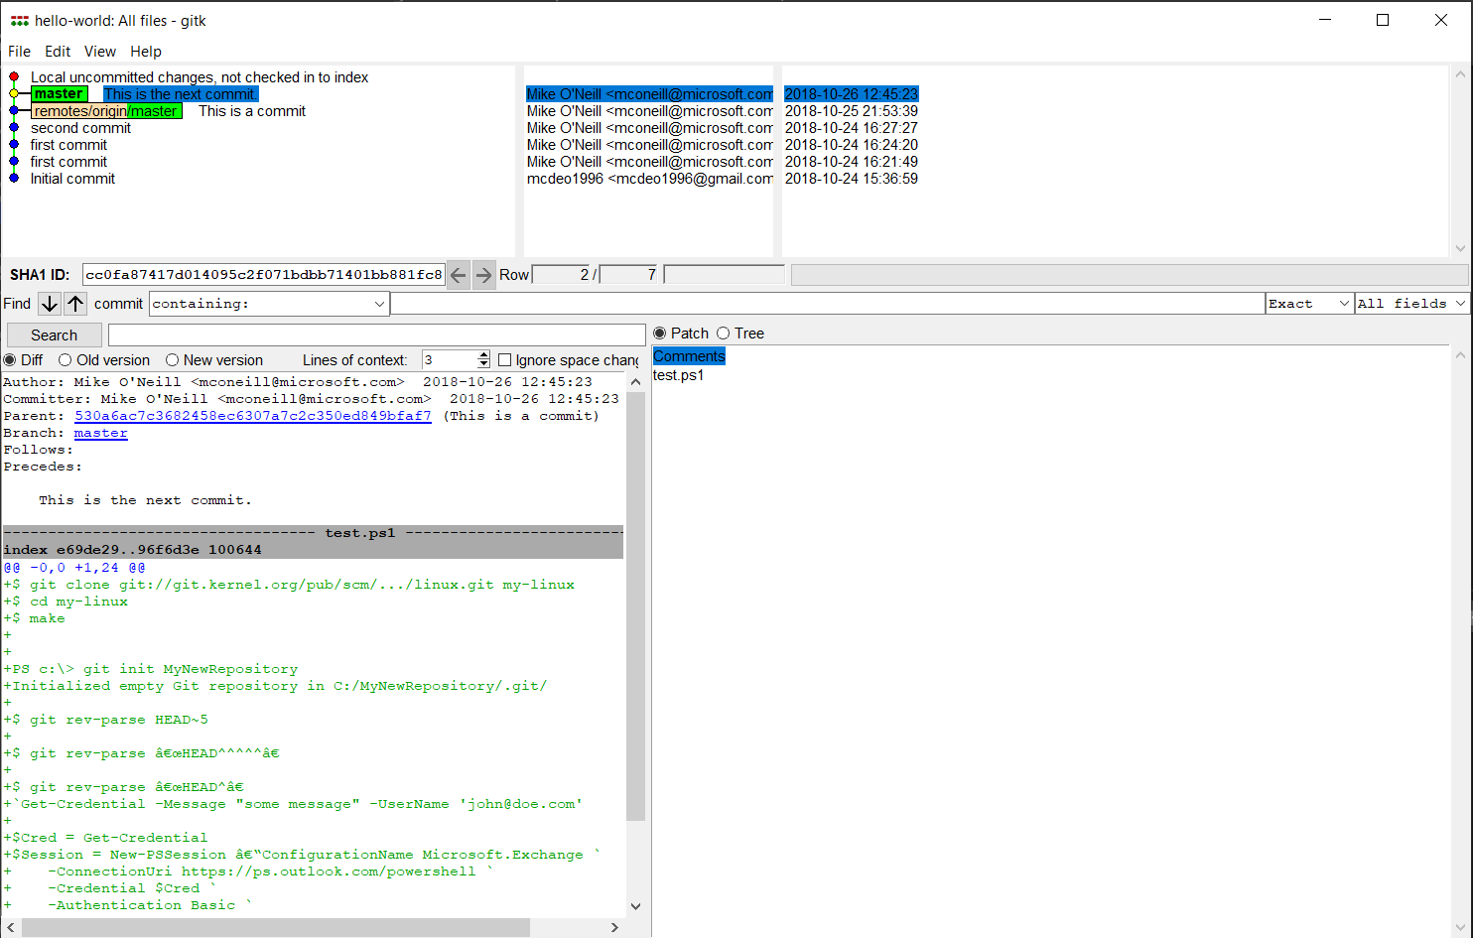
History Options Cont.
Use gitk for a GUI history

Slide 31

Demonstration
Advanced Features
Notes:
Consider demoing this as you go. You can view the demo ps1 and video in the instructor folder.
configure git with a usename and email
Install posh-git
Make a new directory, init a first repo
Make a file, add that file
Show git status
Commit
#need e-mail and user for git repository
git config --global user.name "your name here"
git config --global user.email "your email here"
#install the Posh-git module that has colors and information at the command prompt.
Install-Module posh-git -force
#create folder if not already created
New-Item -ItemType Directory 'c:\temp\Repos' -ea 0
#change directory to new folder created
Set-Location C:\Temp\Repos
#create repo
git init MyFirstRepo
#create file and add content
New-Item myfile.txt | Set-Content -Value "This is some text"
#add files
git add .
#get status of git
git status
#commit to git repo
git commit -m "My first commit"
git commit
#show the log of the git repo changes/commits
git log –oneline
#####

Slide 32

Git – Introduction (30 minutes)
Installing Git
Setting up first repository

